Slide 1

Web Designing Using Wireframes

Slide 2

Roadmap…
Simple web designing concepts
Web development process
Introduction to wireframes
Drawing Wireframes

Slide 3
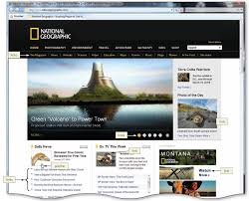
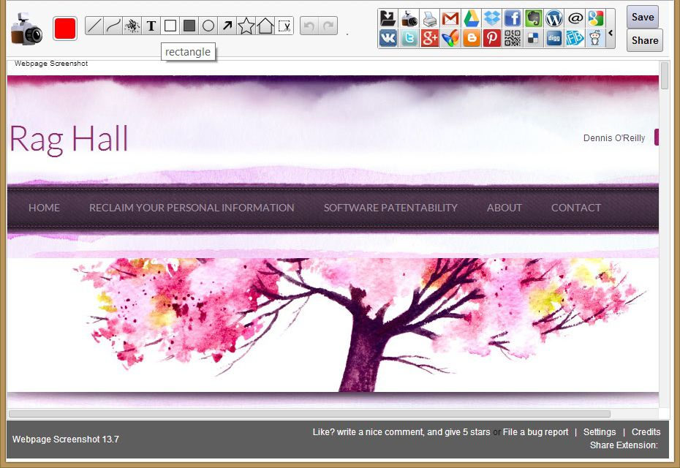

What is in a Web Page??

Slide 4

Things to consider in designing web pages
1. The template
2. The Colors
3. The fonts
4. The layouts
5. The Audience
6. The purpose
7. The content
Etc…

Slide 5
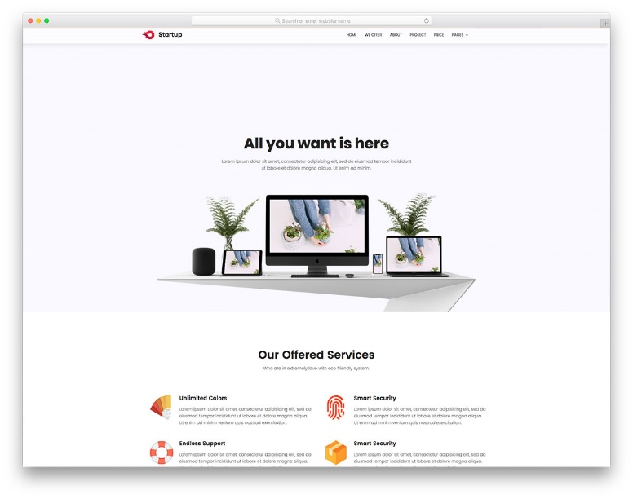
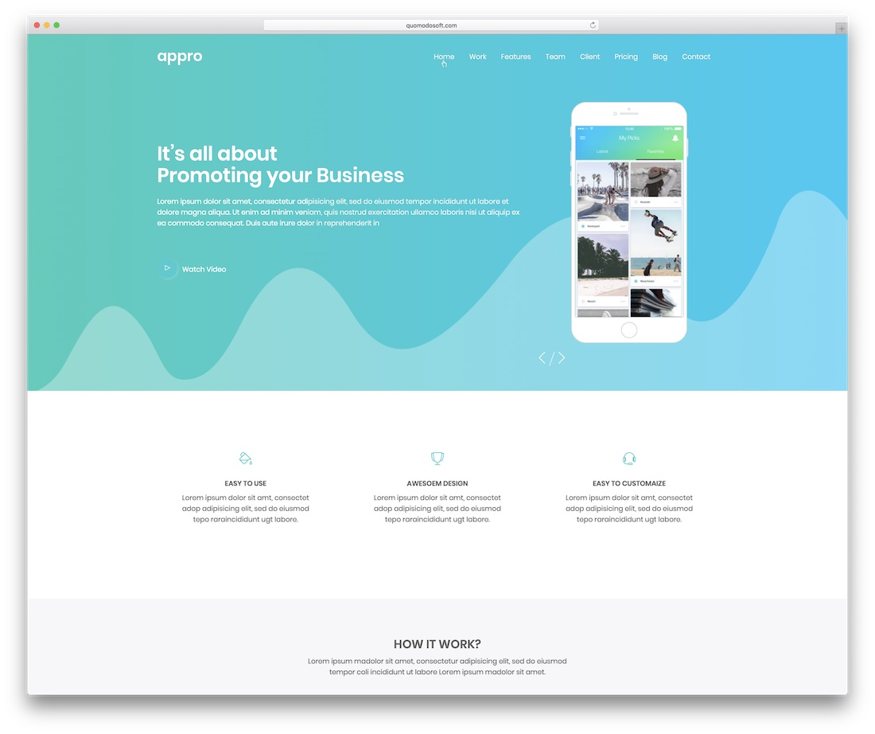
Design Principles 1- Simplicity
Keep the site as simple as possible
Avoid complex structures
Colors. Don't use too many - use a maximum of five (plus or minus two) different colors in your website's design.
Typefaces. A common recommendation is to use a maximum of three different typefaces in a maximum of three different sizes.
Graphics. Only use them if they'll help a user complete a task or perform a specific function (don't just add graphics willy-nilly).

Slide 6
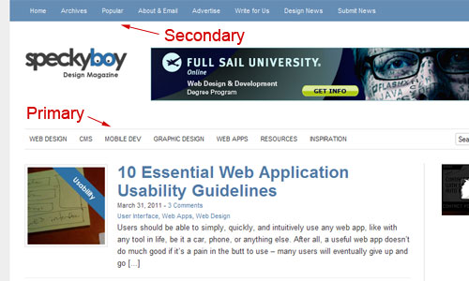
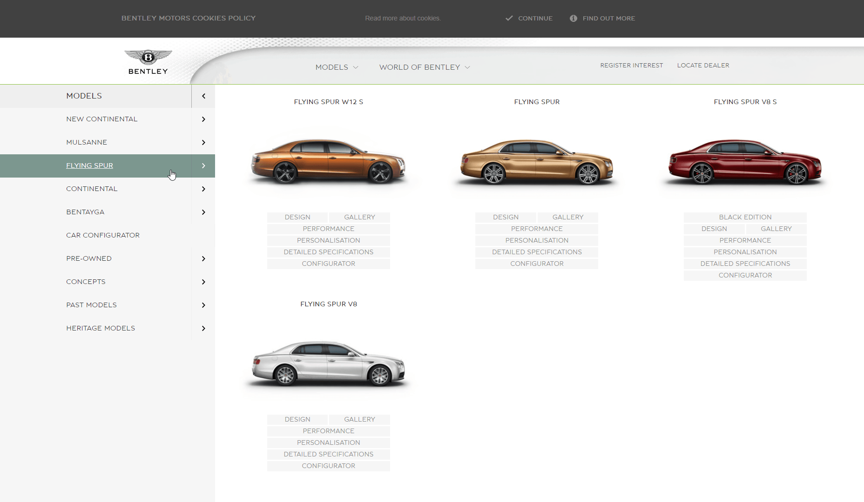
Design Principles 2- Navigability
Having intuitive navigation on the site is crucial for ensuring visitors can find what they're looking for. Ideally, a visitor should be able to arrive on your site and not have to think extensively about where they should click next.
Keep a simple primary navigation.
Include a search box.
Don't offer too many navigation options on a page.

Slide 7
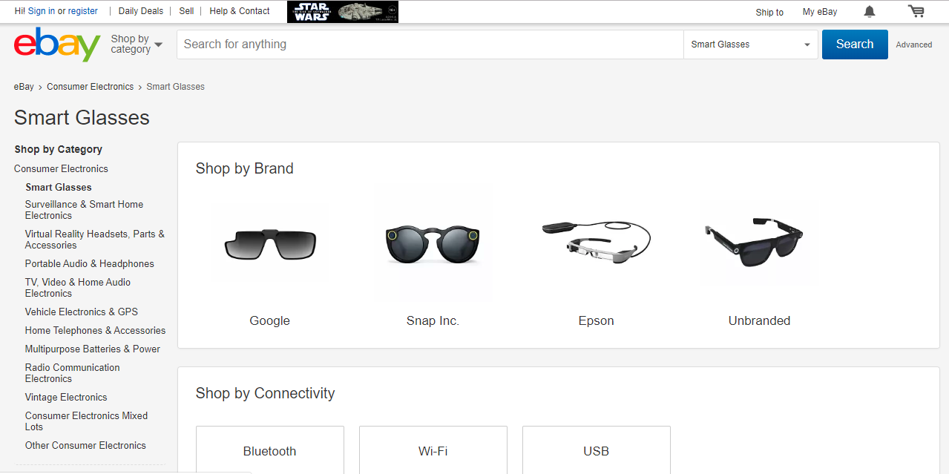
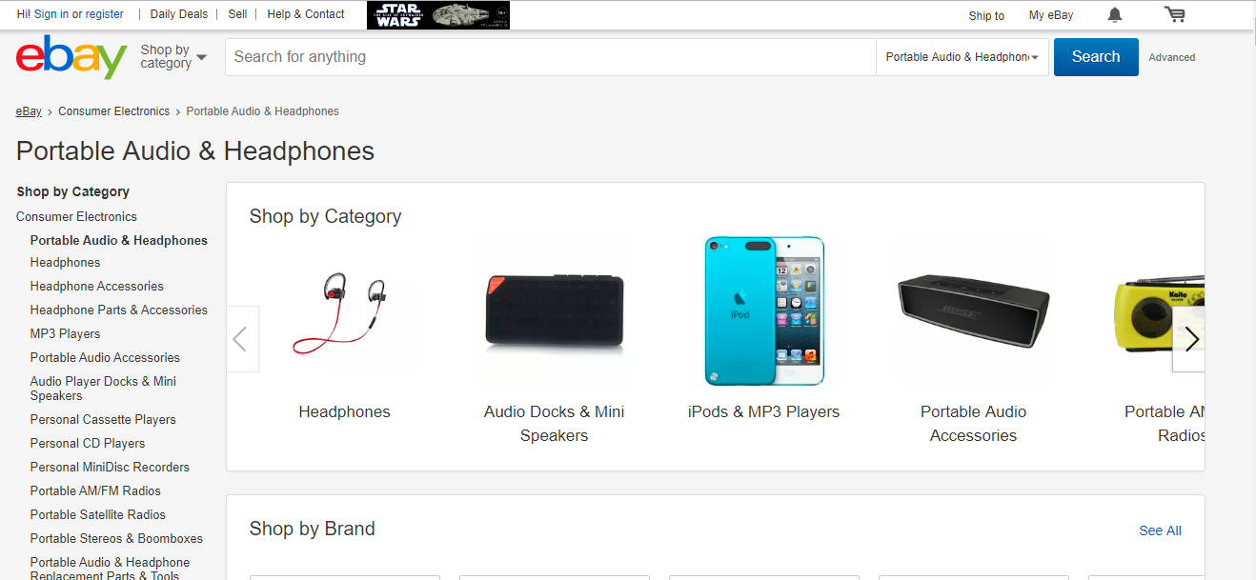
Design Principles 3 - Consistency
Keep the same look and feel throughout the web site

Slide 8
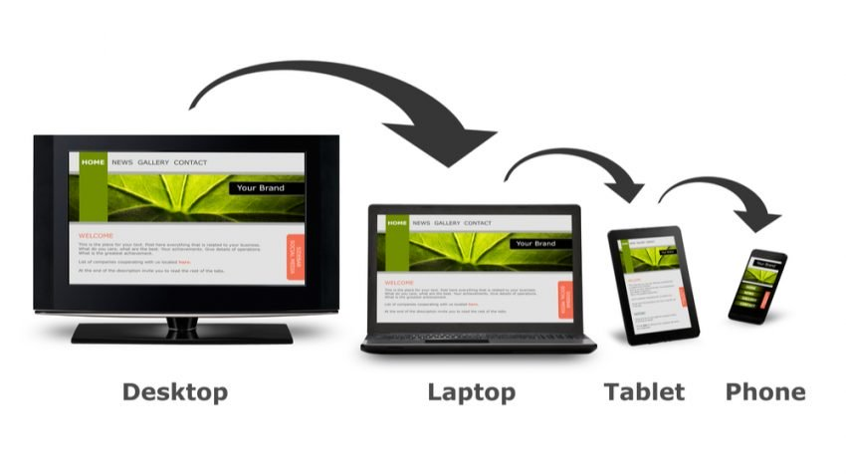
Design Principles 4 - Accessibility
In order to provide a truly great user experience, the site needs to be compatible with the different devices (and operating systems and browsers) that your visitors are using.
At a high-level, this means responsive design. With a responsive site, content is automatically resized and reshuffled to fit the dimensions of whichever device a visitor happens to be using.

Slide 9
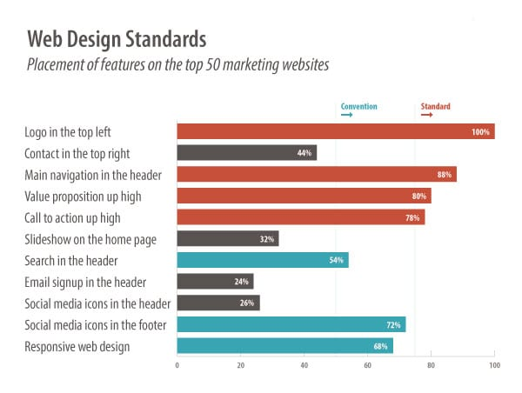
Design Principles 5 – Conventionality and Standards
There are certain web design good practices that has been agreed upon by the web designers over the years such as:
Having the main navigation be at the top (or left side) of a page
Having a logo at the top left (or center) of a page
Having that logo be clickable so it always brings a visitor back to the homepage
Having links change color/appearance when you hover over them

Slide 10
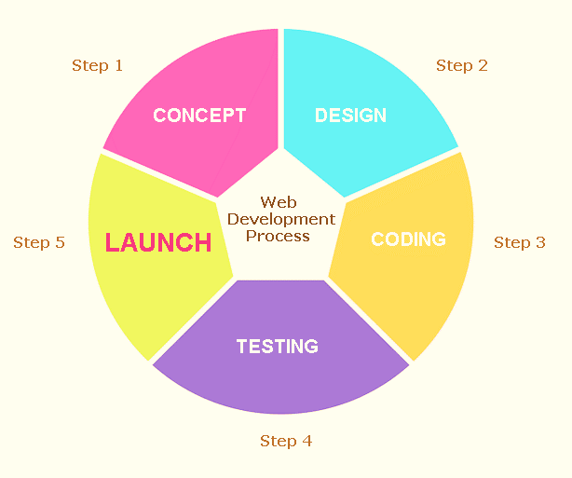
The Web Development Process

Slide 11
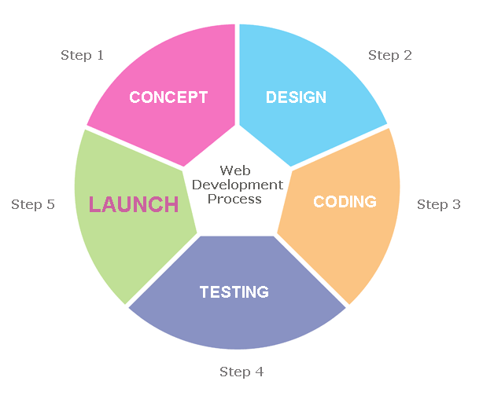
Web development process
Web site development is a process which is very similar to all other software products. It is divided into few phases.
Phase 1 – Concept and Scope
Project summary: The overview of the project.
Goals: What are two or three specific measurable goals that the site should achieve
Target audiences:
Messages: What are the key messages that attract and motivate key audiences to engage with the organization?
Competition: Who are rival organizations that provide similar offerings to your audience? Include an overview of competitive organizations’ Web sites, considering visual branding, messaging, navigation, calls to action and key differentiators.

Slide 12
Web development process
Phase 2 - Design
Developing the Site architecture. This includes the sitemap and wireframes of pages
Phase 3 – Development – Coding the web application
Phase 4 – Testing - Conducting tests before releasing
Phase 5 - Launch

Slide 13
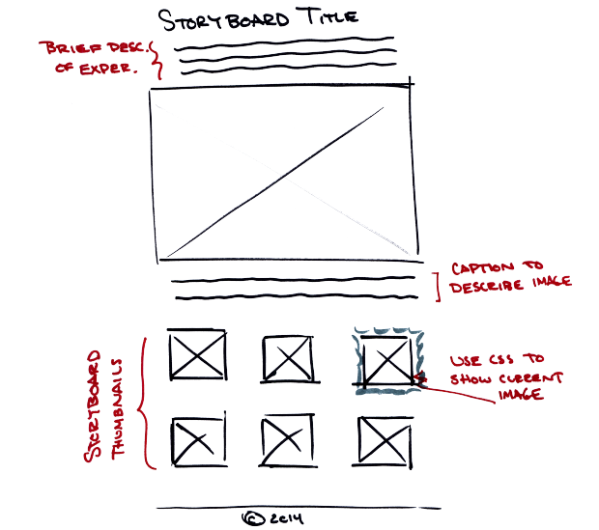
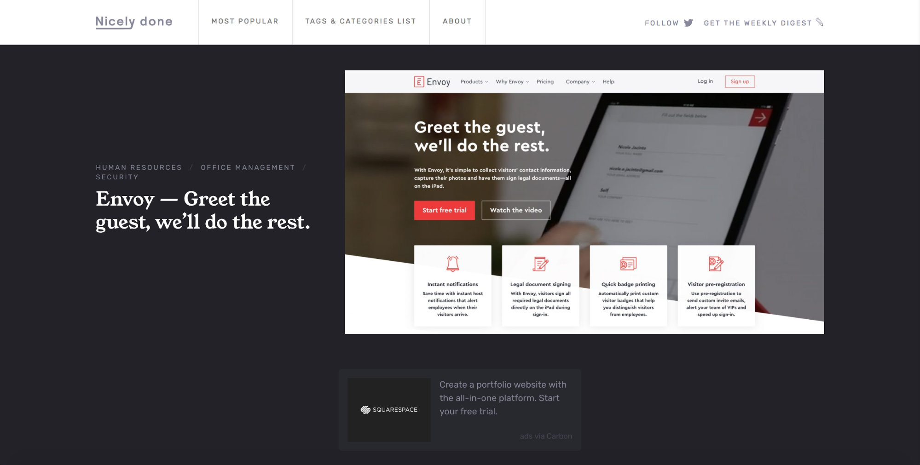
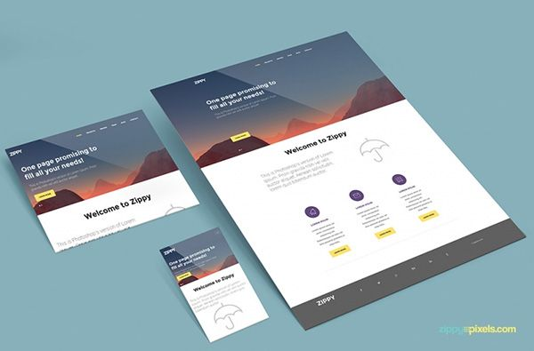
Phase 2 - Designing
Once the concept and the scope is finalized, the web application needs to be designed before starting the implementation.
Designing can be done in 3 ways.
Wireframes - shows the basic elements, not interactive, do not show much detail
Prototypes - a more detailed interactive representation of the final product. It’s a working model and can be used as a testing tool.
Mockups - a static design representation in which the corporate identity is applied through color, typography and visual style.

Slide 14
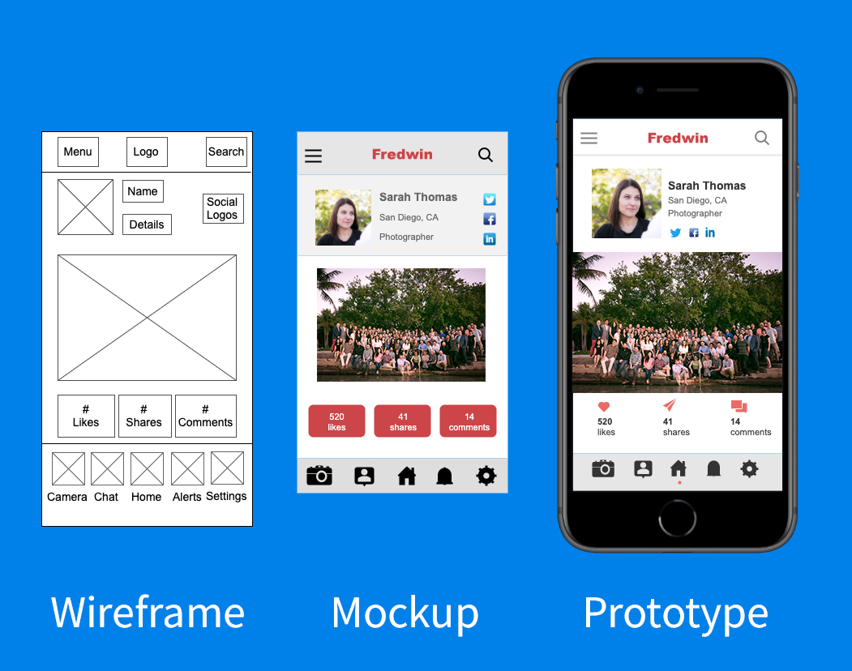

Slide 15
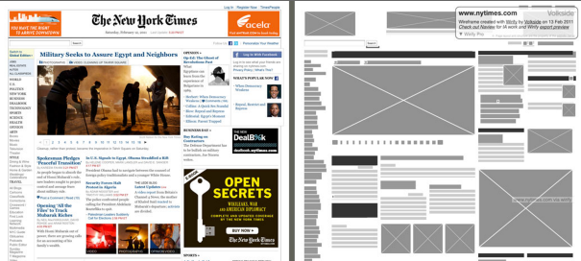
Actual Web Pages Vs. Wireframe

Slide 16
Wireframe – Definition
A wireframe is a low-fidelity design layout that serves 3 simple but exact purposes:
It presents the information that will be displayed on the page
It gives an outline of structure and layout of the page
It conveys the overall direction and description of the user interface
A wireframe is the blueprint of a website. The main purpose is to show the client how the website will be structured before designing.
Wireframes serves as a common language between designers, clients , developers and other stakeholders.

Slide 17

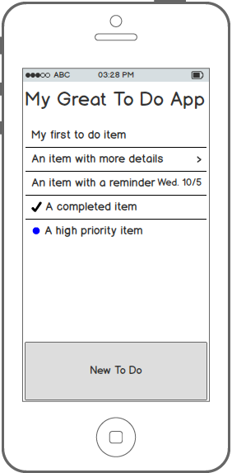
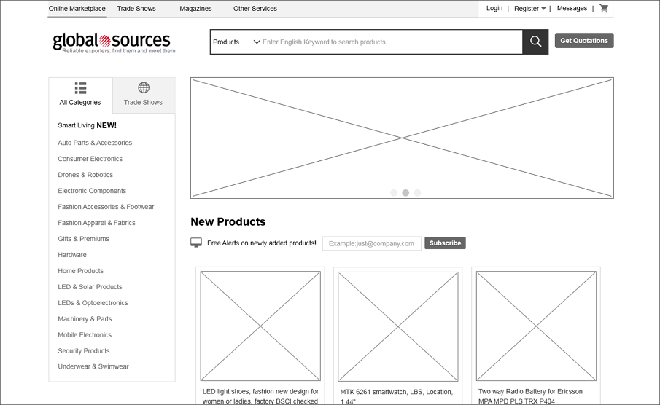
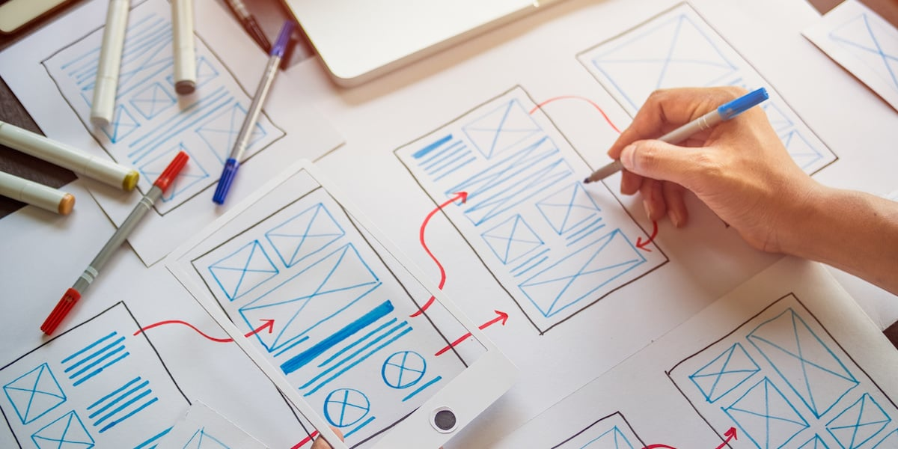
Things to include
Content – What will exactly be displayed in this page?
include actual content
Structure
Hierarchy - positioning, labelling and size
Functionality – buttons, links etc.
Notes:
Content
What will exactly be displayed in this page?
Structure
How will the elements of this page be put together?
Hierarchy
How will these elements be displayed in positioning, labelling and size?
Functionality
How will these elements work together?
Behavior
How does these elements interact with the user?

Slide 18

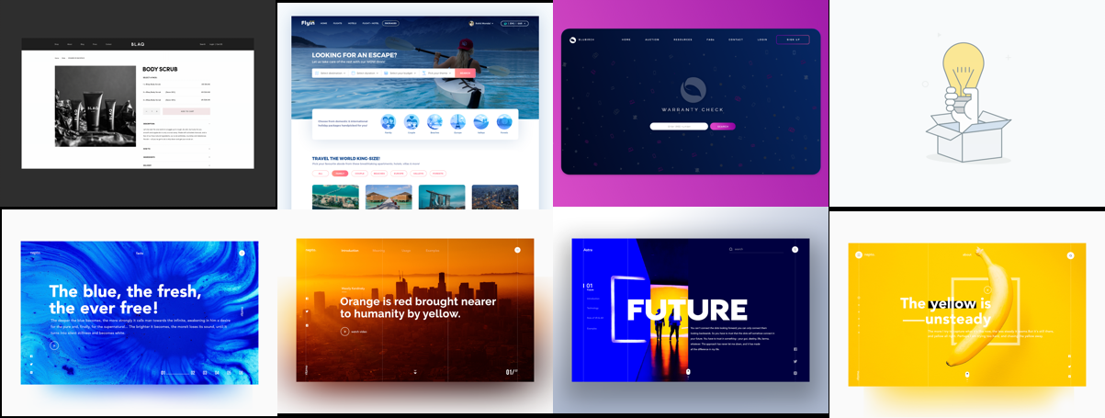
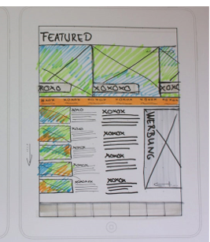
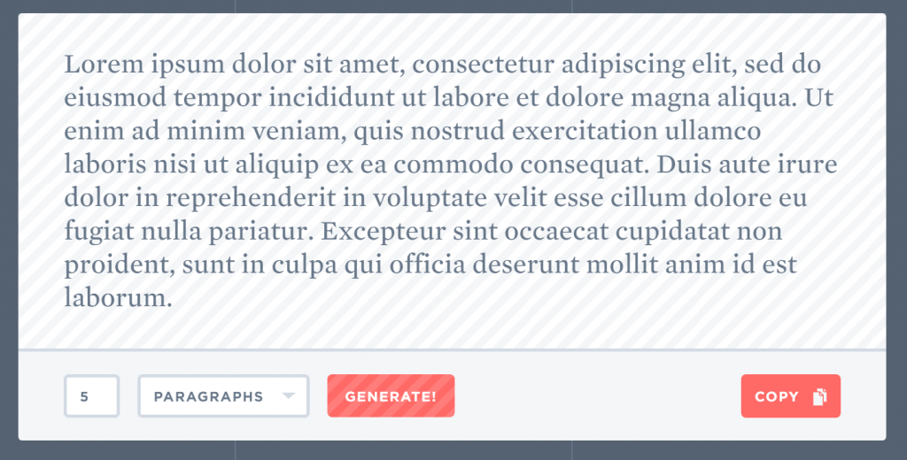
Things not to include
No Graphics – Only lines of black and white
No Dummy text
No Actual colors and designs

Slide 19
Guidelines for drawing proper wireframes
Keep it simple at the start.
Follow a basic layout, such as left link or right link with a header and the content in the middle.
Identify all of the links, if you are using color pencils or pens, pick a link color and stick to it. Identify your graphic image placeholders and note the sizes near them. Identify your content and content type. Remember that you are not putting content here, but content identification.
Remember this will be a layout of where the webpage components will be placed.
It is not a design pre-view.
It will be generic or even ugly, but that is OK.
Sketch out the layout to the best of your ability.
The import thing is that this will be the blueprint for your webpage, and website.

Slide 20
Types of Wireframes
Sketchy
Pen and Paper, Free style
Digital
Software such as illustrator Invision, or Balsamiq
Free and open source software (A lot – just google)

Slide 21
Activity 1 - Group
Get into groups of 3 or 4. Execute the first two phases of the web application development process. (if you need you can use colored pens – Then it becomes a Mockup)
Select one of the below given systems and draw 4 wireframes for specific pages. E.g.: homepage, ordering page, payment page or any other pages you like.
1. A Food ordering system – (like ubereats)
2. A social media site – (like facebook)
3. An e-commerce site – (like ebay)
4. A gaming site – (like PCgamer)

Slide 22
Activity 2 - Individual
Select an online wireframe designing tool using an appropriate search engine.
Draw a set of wireframes assuming that you are going to implement a web application to book movie tickets online.
To get an idea you can explore the functions of the following, but have your own design.
Eg: http://tickets.lk/ , https://www.taktikbook.lk/theaters

Slide 23


Slide 24
Next Lecture……
HTML designing

